Slide 1


Since 2011
Our outcomes are over 5000 trainees.
Get IT Right from RIG

Slide 2

Full Stack Development
Matplotlib
Python and React
Learn, Create, and Shine
Digital Space

Slide 3
Courses
What is Matplotlib?
Installation of Matplotlib
Import Matplotlib
Checking Matplotlib Version
Essential Role of Pyplot in Matplotlib
Types of Plots

Slide 4
What is NumPy?
NumPy is a Python library used for working with arrays.
It also has functions for working in domain of linear algebra, fourier transform, and matrices.
NumPy was created in 2005 by Travis Oliphant. It is an open source project and you can use it freely.
NumPy stands for Numerical Python.

Slide 5
Why Use NumPy?
In Python we have lists that serve the purpose of arrays, but they are slow to process.
NumPy aims to provide an array object that is up to 50x faster than traditional Python lists.
The array object in NumPy is called ndarray, it provides a lot of supporting functions that make working with ndarray very easy.
Arrays are very frequently used in data science, where speed and resources are very important.

Slide 6

Create a NumPy ndarray Object
import numpy as np arr = np.array([1, 2, 3, 4, 5]) print(arr) print(type(arr))
import numpy as np arr = np.array((1, 2, 3, 4, 5)) print(arr)

Slide 7
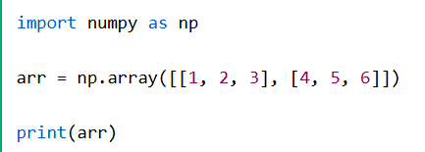


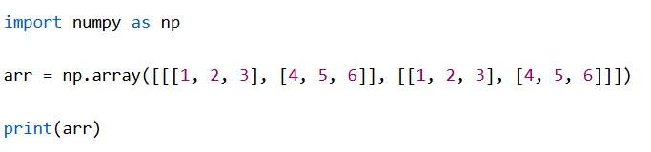
Dimensions in Arrays
import numpy as np arr = np.array([1, 2, 3, 4, 5]) print(arr)

Slide 8

Higher Dimensional Arrays
import numpy as np arr = np.array([1, 2, 3, 4], ndmin=5) print(arr) print('number of dimensions :', arr.ndim)

Slide 9
NumPy Array Indexing
import numpy as np arr = np.array([1, 2, 3, 4]) print(arr[0])
print(arr[1])

Slide 10
NumPy Array Indexing
import numpy as np
arr = np.array([1, 2, 3, 4])
print(arr[2] + arr[3])

Slide 11
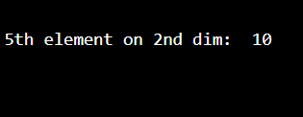
Access 2-D Arrays
import numpy as np arr = np.array([[1,2,3,4,5], [6,7,8,9,10]]) print('5th element on 2nd row: ', arr[1, 4])

Slide 12
NumPy Array Slicing
Slicing in python means taking elements from one given index to another given index.
We pass slice instead of index like this: [start:end].
We can also define the step, like this: [start:end:step].
If we don't pass start its considered 0
If we don't pass end its considered length of array in that dimension
If we don't pass step its considered 1

Slide 13



NumPy Array Slicing
import numpy as np
arr = np.array([1, 2, 3, 4, 5, 6, 7])
print(arr[1:5])
import numpy as np
arr = np.array([1, 2, 3, 4, 5, 6, 7])
print(arr[4:])
import numpy as np
arr = np.array([1, 2, 3, 4, 5, 6, 7])
print(arr[:4])

Slide 14

Slicing 2-D Arrays
import numpy as np
arr = np.array([[1, 2, 3, 4, 5], [6, 7, 8, 9, 10]])
print(arr[1, 1:4])

Slide 15
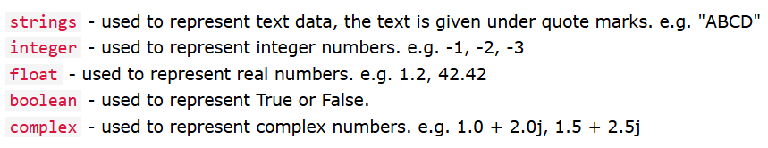
Python Data Types

Slide 16
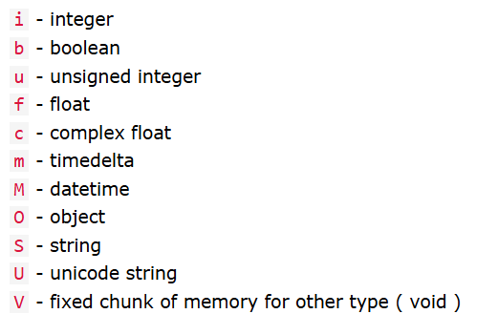
Numpy Data Types

Slide 17


NumPy Array Iterating
import numpy as np
arr = np.array([1, 2, 3])
for x in arr:
print(x)
import numpy as np
arr = np.array([[1, 2, 3], [4, 5, 6]])
for x in arr:
print(x)

Slide 18
Using nditer()
import numpy as np
arr = np.array([[[1, 2], [3, 4]], [[5, 6], [7, 8]]])
for x in np.nditer(arr):
print(x)

Slide 19

Joining NumPy Arrays
import numpy as np
arr1 = np.array([1, 2, 3])
arr2 = np.array([4, 5, 6])
arr = np.concatenate((arr1, arr2))
print(arr)

Slide 20
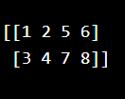
Join two 2-D arrays
import numpy as np
arr1 = np.array([[1, 2], [3, 4]])
arr2 = np.array([[5, 6], [7, 8]])
arr = np.concatenate((arr1, arr2), axis=1)
print(arr)

Slide 21

Joining Arrays Using Stack Functions
import numpy as np
arr1 = np.array([1, 2, 3])
arr2 = np.array([4, 5, 6])
arr = np.stack((arr1, arr2), axis=1)
print(arr)

Slide 22


Stacking Along Rows and Colum
import numpy as np
arr1 = np.array([1, 2, 3])
arr2 = np.array([4, 5, 6])
arr = np.hstack((arr1, arr2))
print(arr)
import numpy as np
arr1 = np.array([1, 2, 3])
arr2 = np.array([4, 5, 6])
arr = np.vstack((arr1, arr2))
print(arr)

Slide 23
Searching Arrays
import numpy as np arr = np.array([1, 2, 3, 4, 5, 4, 4]) x = np.where(arr == 4) print(x)

Slide 24
Search Sorted
import numpy as np
arr = np.array([6, 7, 8, 9])
x = np.searchsorted(arr, 7)
print(x)

Slide 25
Search Sorted
import numpy as np
arr = np.array([6, 7, 8, 9])
x = np.searchsorted(arr, 7)
print(x)
import numpy as np
arr = np.array([6, 7, 8, 9])
x = np.searchsorted(arr, 7, side='right')
print(x)

Slide 26
Sorting Arrays
import numpy as np arr = np.array([3, 2, 0, 1]) print(np.sort(arr))
import numpy as np arr = np.array([[3, 2, 4], [5, 0, 1]]) print(np.sort(arr))

